Slide 1

Liver Disease Prediction
Farhanur Rahaman
ID:1610432642

Slide 2
Data Description:
Dataset= from Kaggle
584 instances
11 attributes including the class attribute:
Attributes:
Age of the patient
Gender of the patient
Total Bilirubin
Direct Bilirubin
Alkaline Phosphatase
Alamine Aminotransferase
Aspartate Aminotransferase
Total Proteins
Albumin
Albumin and Globulin Ratio
Result (Class attribute)

Slide 3
Basic analysis:
4 missing values in “Albumin_and_Globulin_Ratio”
The predicting attribute “Result” : 1 (416 instances with liver disease)
2 (167 instances with no liver disease)
Similar behavior found between some features

Slide 4
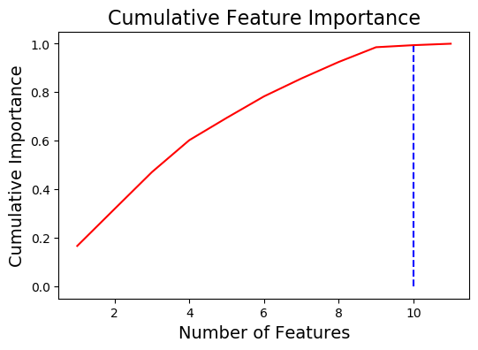
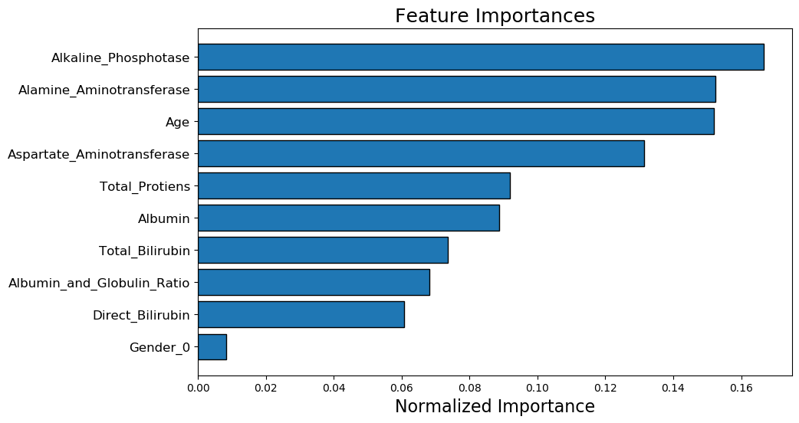
10 features required for 0.99 of cumulative importance

Slide 5
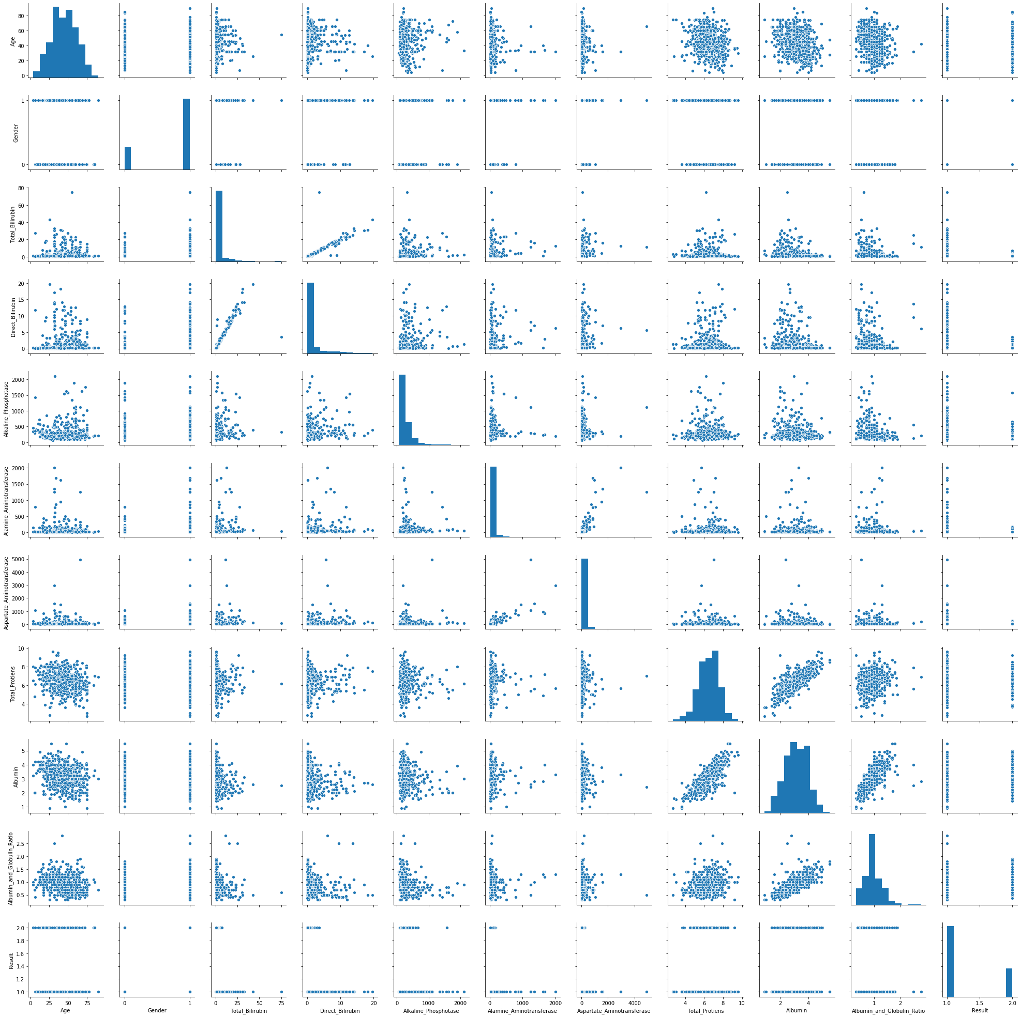
Pair plot

Slide 6
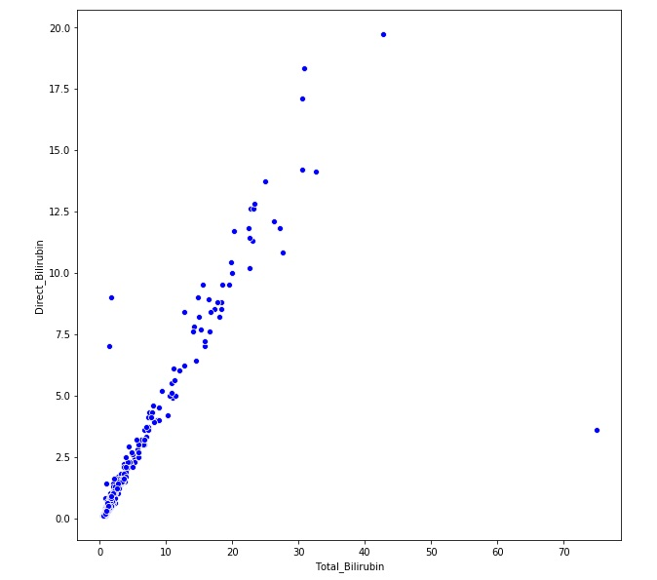
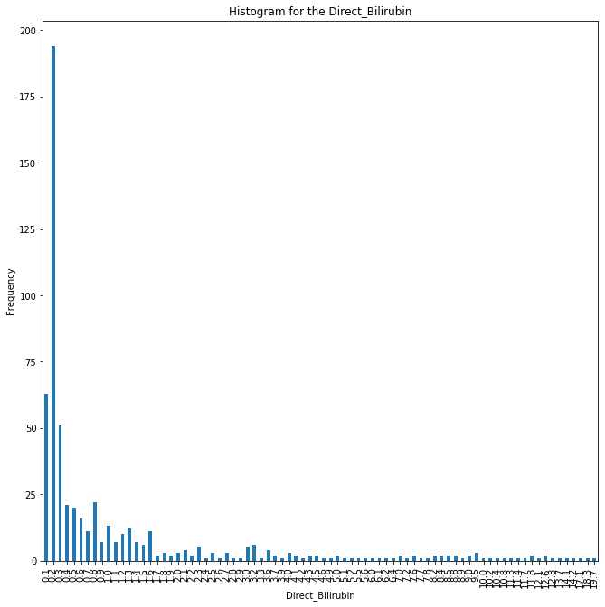
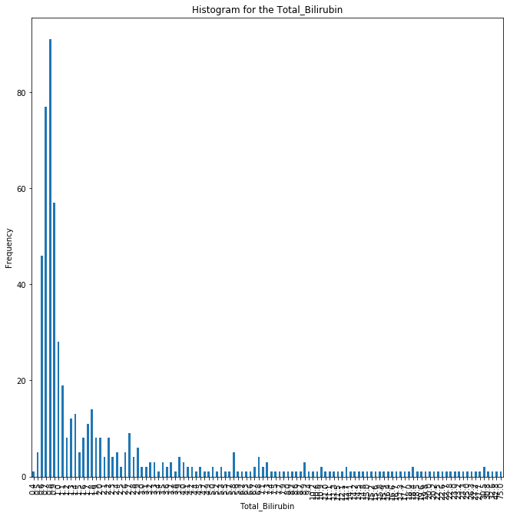
between Total Bilirubin and
Direct Bilirubin
Direct Bilirubin
Total Bilirubin

Slide 7
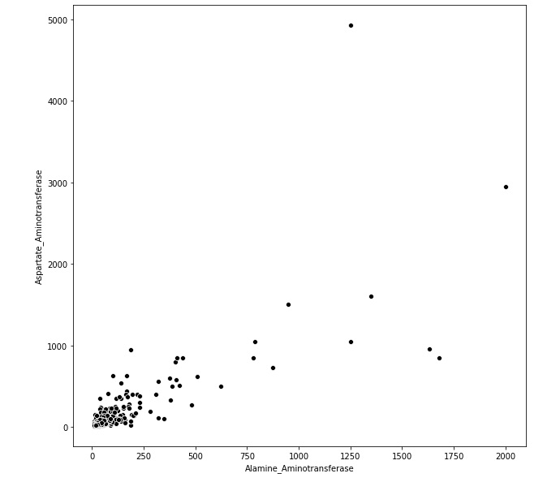
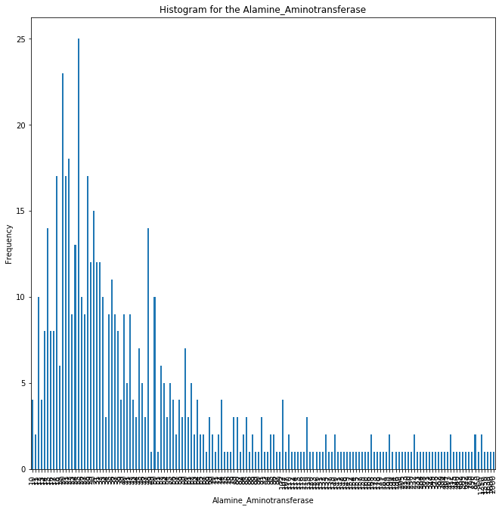
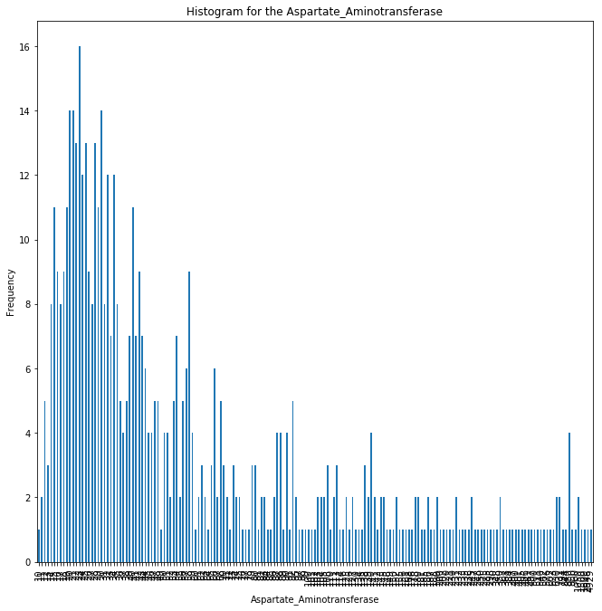
Between Alamine Aminotransferase and
Aspartate Aminotransferase
Aspartate Aminotransferase
Alamine Aminotransferase

Slide 8
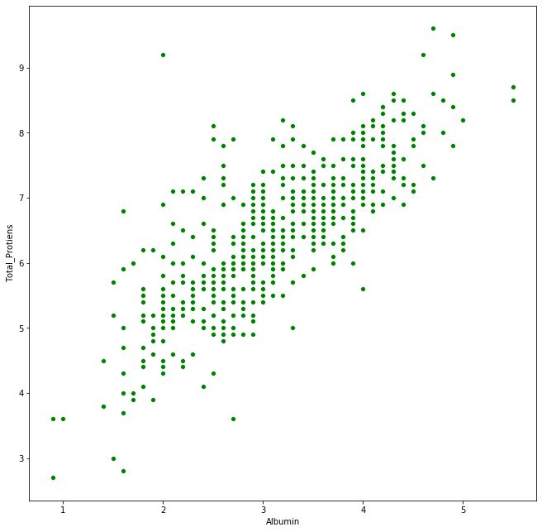
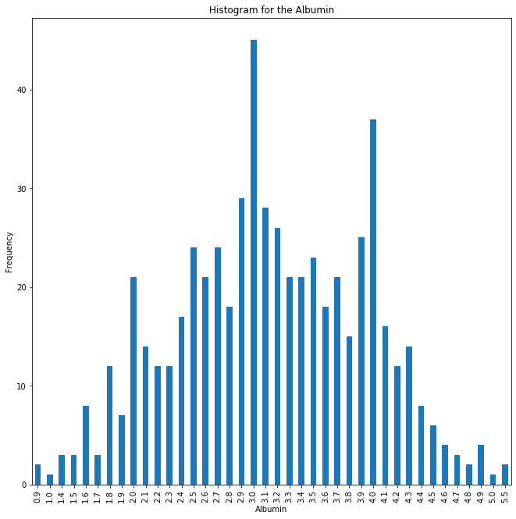
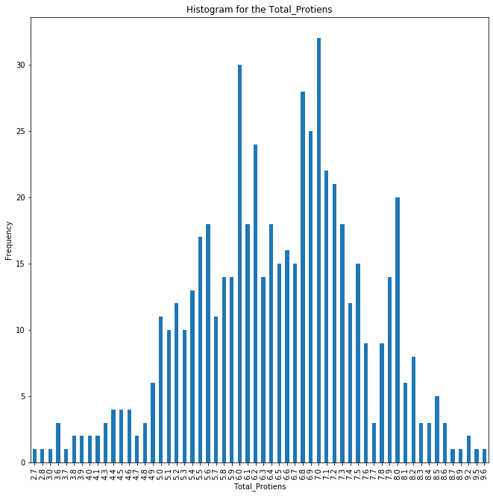
Between Total protein and
Albumin
Albumin
Total protein

Slide 9
Pre-processing:
removed:
Removed Gender
Direct billirubin
Aspartate Aminotransferase
Albumin
Filled the 4 empty cells with the mean value of the column
Divided the dataset into: 1. Training and 2.Test(20% of the whole)

Slide 10
Results(using Logistic Regression):
Raw data: Train accuracy= 73.17%
Test accuracy= 70.94%
After removing 3( GenderDirect ,billirubin,Aspartate Aminotransferase) features:
Train accuracy= 73.17%
Test accuracy= 70.94%
After removing Albumin(total 4 features):
Train accuracy= 73.17%
Test accuracy= 70.94%

Slide 11
Results(using Random forest):
Raw data: Train accuracy= 100%
Test accuracy= 70.09%
After removing 3( GenderDirect ,billirubin,Aspartate Aminotransferase) features:
Train accuracy= 100%
Test accuracy= 69.45%
After removing Albumin:
Train accuracy= 100%
Test accuracy= 70.94%

Slide 12
Thank you.

